Slide 1
Vertebrates

Slide 2
Most chordates are vertebrates.
Vertebrates are animals that are members of the subphylum Vertebrata (chordates with backbones).

Slide 3
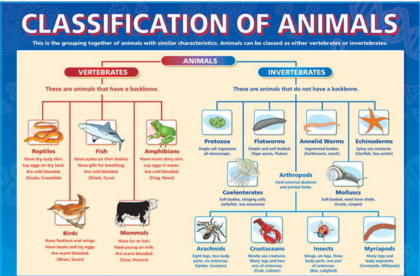

Slide 4
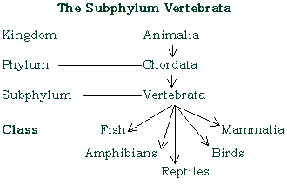

Slide 5
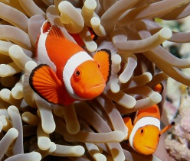
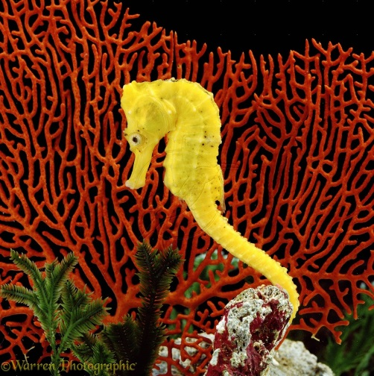
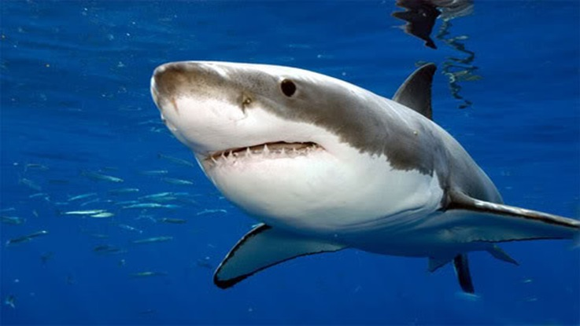
Fish
These organisms lives in the water (marine or fresh water)
The endoskeleton is cartilaginous or bony.
Their body is streamlined
The body of the fish is covered in scales and has fins attached to help it move through the water.
Fish breathe using gills which take oxygen out of the water.
When male and female fish mate, the eggs often meet the sperm in the water. This is called external fertilization.
Example: Sharks, trouts, eels, tunas, seahorse, pirahnas, salmons, etc.

Slide 6
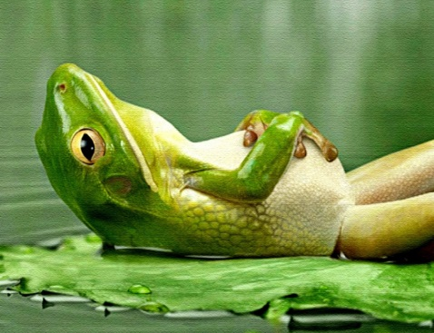
Amphibians
The name Amphibia (Greek - Amphi) meaning life.
Ampibians can live both in aquatic and terrestrial habitats.
The skin of these animals are scaleless and moist. The skin is very thin and must always be kept wet because amphibians breathe through their skin.
They are cold-blooded animals.
Fertilization of the eggs is external, taking place in the water. The eggs are covered with jelly to protect them. The larvae, called tadpoles, are aquatic.
Adult amphibian lives on land but always near water.
Example: Toad, frog, salamander.

Slide 7
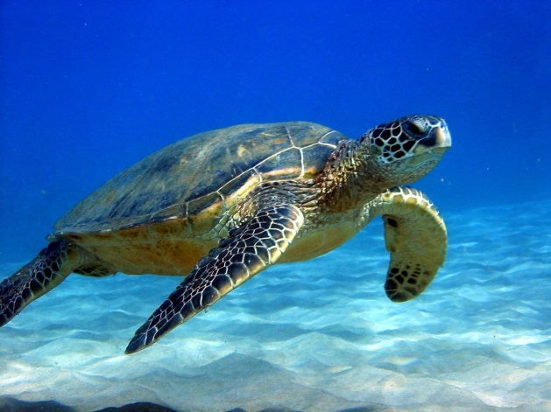
Reptiles
In Latin (reptum) means to creep or crawl, hence, the class name refers to locomotion that is of creeping or crawling mode.
Reptiles live on land, although many of them swim well and may feed in water, such as some snakes and lizards.
Their body is covered dry scales.
Some animals like the snake and the lizards shed their skin.
When male and female mate fertilization is internal. The female lays soft-shelled eggs which are often buried in sand or in the earth to protect them while the young develop inside.
Example: Turtle, Chameleon, crocodile.

Slide 8
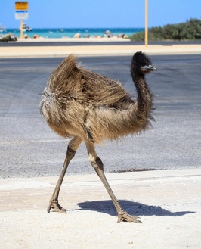
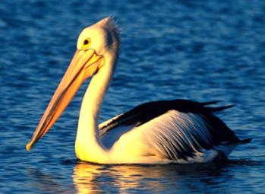
Birds
The characteristic feature of birds is the presence of feathers.
They do not have teeth but use their beaks to eat their food.
Their front limbs are adapted as wings, although not all birds fly. The hind limbs are modified for walking, swimming or clasping and generally have scales.
The skin is dry
Endoskeleton is bony, and the bones are hollow with air cavities.
They are warm-blooded animals.
Fertilization is internal and the females lay eggs with hard shells, usually in a nest. Most birds incubate their eggs until the eggs hatch.
Example: Crow, Pigeon, Parrot and the penguin.

Slide 9
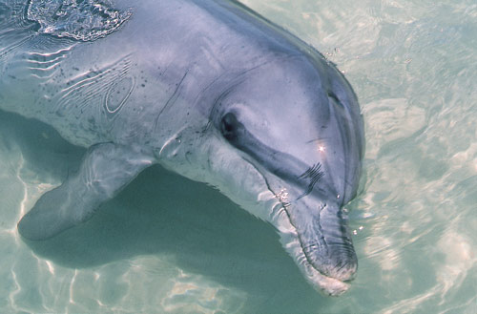
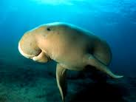
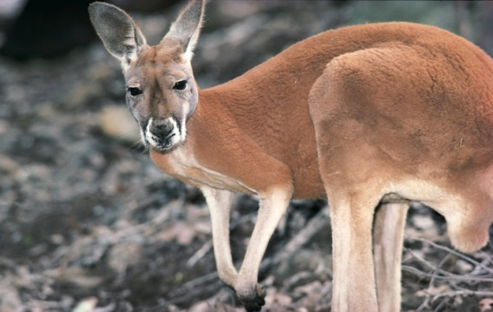
Mammalia
Mammals are present in almost all habitats - polar ice caps, deserts, mountains, forests, and grasslands.
The unique characteristic of the class mammalia is the presence of milk producing glands (mammary glands), by which the young ones are nourished.
The skin is covered with hairs.
Fertilization is internal and offspring are kept inside the female's body and feed through a placenta.
Females feed their young with milk from their mammary glands.
Example: Kangaroo, Tiger, Lion, Platypus etc.

Slide 10
